Slide 1
The Old Man and the sea ernest hemingway
Self
Fashioning
Trainee’s Name: MD. Isfak Ali
Trainee’s ID: IS-01-24

Slide 2
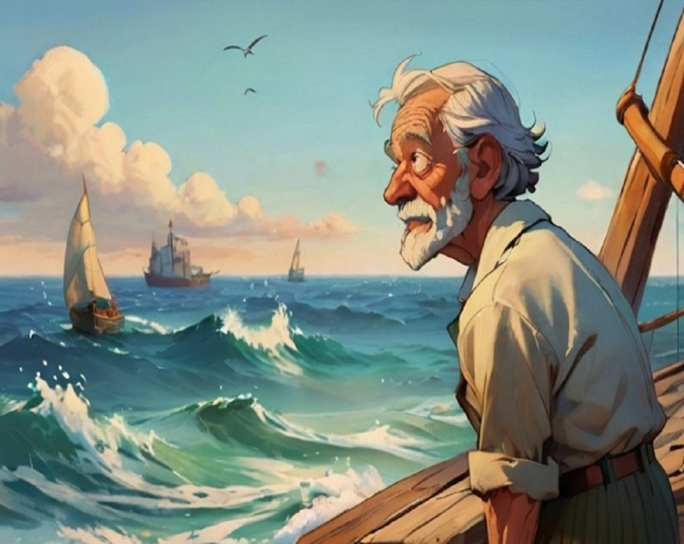
The boy: I could go with you again.
We’ve made some money
Santiago: No

Slide 3
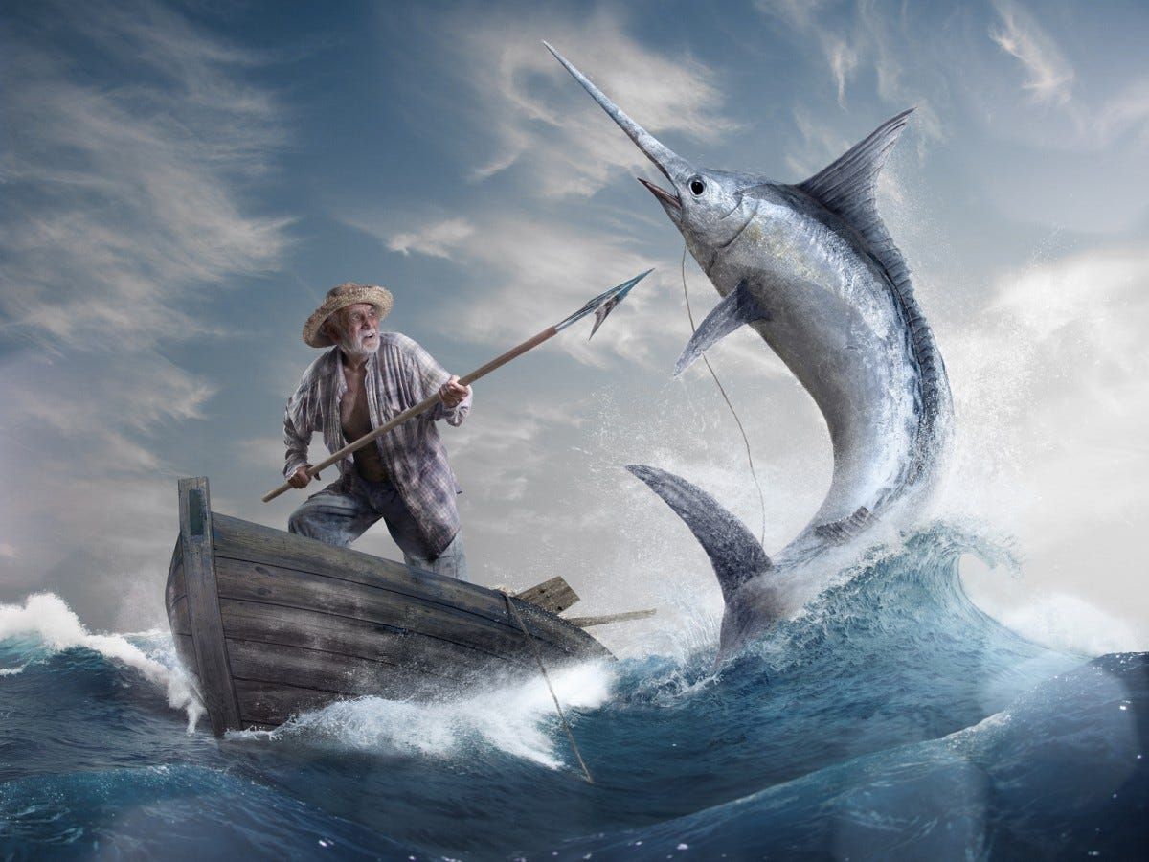
Social Expectations
Personal Values
Existential Challenges
Building Own Identity

